Slide 1
IWPA 2015-2016 Championships

Slide 2
IWPA
Regional Hall of Fame
2015-2016 Season

Slide 3
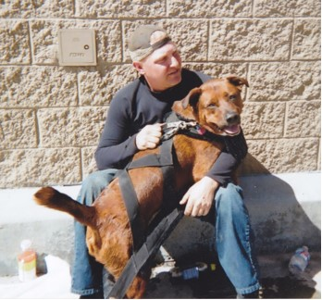
REGION 9
Galyith
Owner/Handler:
Richard Felice Sr.

Slide 4
IWPA
International
Hall of Fame
Inductee’s
2014 - 2015

Slide 5
June 6, 2015
International Hall of Fame inductee’s
No Inductees submitted
2014 - 2015 Season

Slide 6
Congratulations to all International and Regional Hall of Fame recipients!!!

